Slide 1

Amazon Alexa Automation Food ordering using Alexa Routine SESSION 2022-23
Department of Information Technology
ABES Engineering College, Ghaziabad, UP
Name- Harsh Kumar
Class & Section: CS-DS
Roll No. – 2000321540027
Admission No. - 2020B1541056

Slide 2
Contents:
Abstract
introduction
Related Work
3. design process
4. Alexa ROUTINE
- Behavior Adaption
- Pre-defined Option Storage
- Human Confirmation

Slide 3
ABstract
The widespread adoption of intelligent voice assistants (IVAs), like Amazon’s Alexa, presents new opportunities for designers of persuasive technologies to explore how to support people’s behavior change goals and habits with voice technology. In this work, I am going to explore how to use Alexa Routines, a technique from behavior science to make specific and effective plans, with IVAs.I design and conduct usability of Alexa’s Routines and sub routines to make this work. We identify strategies that make it possible to successfully adapt planning prompts to voice format. The planing of a food delivering application is under process.

Slide 4
Introduction
People encounter problems in translating their goals into action — often termed the intention-behavior gap or simply procrastination. The use of IOT devices can be a way to be productive when you don’t feel like working. In the this new world of technology the average man have huge amount of stress along with overwhelming amount of tasks. From a study done in MIT Psychology Grad Students in 2019, the early man have very slightest of task in compression of the current generation of humanoid, and this rate is hiking toward the Gen Z.

Slide 5
Related work
IVAs are voice-based software agents that can perform tasks upon request— they use natural language processing to derive intent from requests made by their users, and respond to those requests using speech and/or another modality (e.g., graphical output). We focused on the intersections of IVAs and behavior change which is currently nascent. We discuss existing work surrounding IVAs for behavior change and planning prompts research in context of persuasive and behavior change technology.

Slide 6
Design Process
In this work, I’ve employ a research through design approach to explore how the behavioral science technique of Alexa’s Routine might be adapted from written to spoken format. Our design goal was to create a voice app or skill (Amazon’s terminology for apps that run on their Alexa platform) that elicits spoken-out-loud planning prompts (see Figure 1). We relied on evidencebased techniques from behavioral science paired with an iterative design process to make this technology engaging and persuasive.

Slide 7
Behavior Adaption
The behavior adaption is done using Amazon’s Alexa Routine which uses Machine Learning technology. A persons behavioral attributes are reflected in his/her voice, to catch this behavioral attributes Alexa need a huge amount of data of N no. Of people to execute a working model on understanding a particular person.

Slide 8
Pre-defined Option Storage
To execute this automation the Alexa Echo needs to be connected with a IFFF supporting application. The application is connected with the Echo through the AWS Cloud Instance. The AWS (Amazon Web Service) is used to accept a JSON File (Java Script Oriented Notation) have a key value attributes which contain the data needed for the execution of program.

Slide 9
Human Confirmation
To final exude “Food Ordering” using Alexa routine a human confermation is needed to reduce any error in execution. A notification will be sent on the device for Order Confermation.

Slide 10
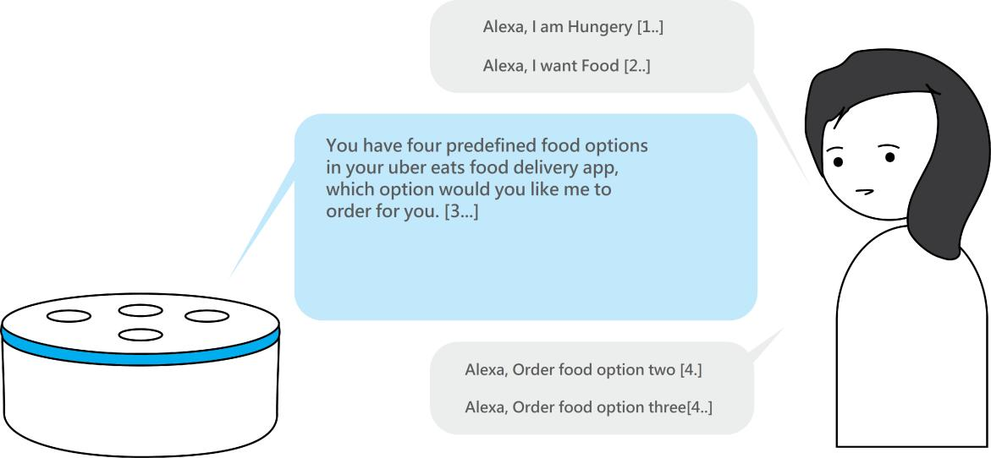
Alexa Routine (Food Ordering)

Slide 11







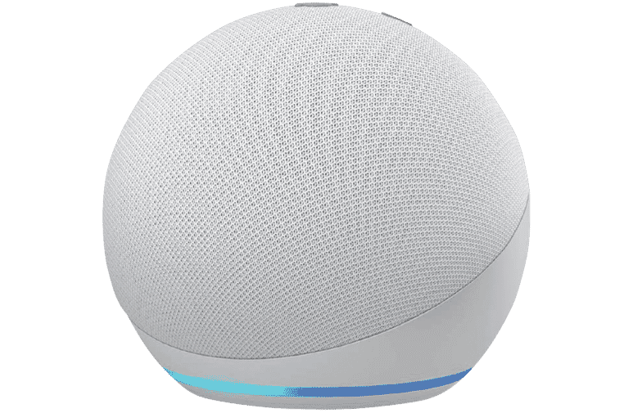
How it work?

Slide 12
1. ANDROID APPLICATION
(Implimentaion : 25 Nov’ 2022)
The implementation from ALEXA echo to an "Android" application is done using Amazon's Alexa Application by creating routines and subroutines.
The sub routines and routines work on machine learning and Deep Learning. It can differentiate between the voice of different users and can give specific answers concerned with that specific user.

Slide 13
THANK YOU

